Slide 1
DEPI Network Administration
Computer Networks
Interconnecting Enterprise Networks
Designing IP Addressing for Multi-Site Connectivity

Slide 2
Project Overview
02
01
01
Objectives
Scope
02

Slide 3

02
01
Objectives
This project involves designing and documenting the network architecture of two interconnected enterprises .
The goal is to ensure efficient communication, redundancy, and scalability while implementing advanced services like DHCP, DNS, and dynamic routing protocols Connectivity .

Slide 4
Technical Requirements
02
01
Scope
The network will connect two enterprises, each has its hierarchical model .
This involves reliable Layer 2 and Layer 3 connectivity within each enterprise and between the two

Slide 5
NETWORK TOPOLOGY
Technical Requirements
OSPF
BGP
Management
VLAN segmentation for network management and security
the IGP for routing within each enterprise
manage routing between the two enterprises
02
01
Availability
DHCP
DNS
Redundant multilayer switches (Active & standby)
for applying Name Resolution
Dynamic IP Allocation

Slide 6
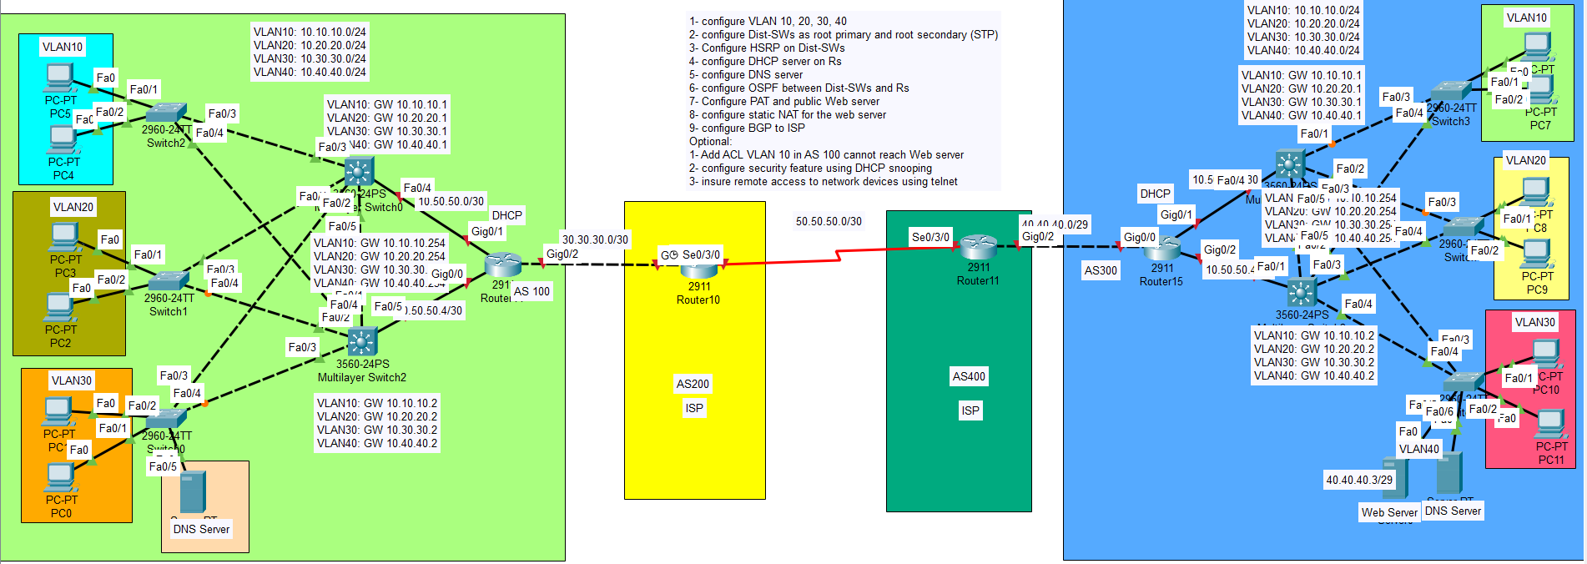
Technical Requirements
IP Addressing Scheme
NETWORK TOPOLOGY
Each enterprise's network topology follows a hierarchical model with:
Core Layer: 3 switches fully connected to each other, with one router handling external BGP connections to the second enterprise.
Distribution Layer: 2 multilayer switches (one active, one standby) connected the routers to handle VLAN traffic.
Access Layer: Each multilayer switch connects to the routers, managing the various VLANs for the departments.

Slide 7
NETWORK TOPOLOGY
IP Addressing Scheme
Enterprise 1:
Enterprise 2:
Network: 4 vlans AS 100
Subnets:
VLANs:
VLAN 10 (Management): 10.10.10.0/24
VLAN 20 (Users): 10.20.20.0/24
VLAN 30 (Servers): 10.30.30.0/24
VLAN 40 (DNS) : 10.40.40.0/24
DHCP will be configured on the distribution layer (multilayer switch) to provide dynamic IPs in the range: 10.10.10.1/24 : 10.0.0.254/24
Note That:(10.10.10.1,10.10.10.2,10.10.10.254) =>reserved
Network: 4 vlans AS 100
Subnets:
VLANs:
VLAN 10 (Management): 10.10.10.0/24
VLAN 20 (Users): 10.20.20.0/24
VLAN 30 (Servers): 10.30.30.0/24
VLAN 40 (DNS) : 10.40.40.0/24
DHCP will be configured on the distribution layer (multilayer switch) to provide dynamic IPs in the range: 10.10.10.1/24 : 10.0.0.254/24
Note That:(10.10.10.1,10.10.10.2,10.10.10.254) =>reserved

Slide 8
VLAN AND SEGMENTATION
IP Addressing Scheme
OSPF:
OSPF automatically updates routing tables in response to network changes, such as the addition or failure of links. This ensures that data packets are always routed through the most efficient paths.
OSPF supports a hierarchical network design using areas. This helps to manage larger networks by reducing the size of routing tables and minimizing the amount of routing information exchanged. The backbone area (Area 0) connects other areas, enhancing scalability and performance.
ROUTING PROTOCOLS
BGP:
BGP facilitates routing between two separate enterprise networks, often referred to as Autonomous Systems (ASes). It enables seamless communication and data exchange between different organizational networks.

Slide 9
NETWORK TOPOLOGY
VLAN AND SEGMENTATION
VLAN 10:
VLAN 20:
Management traffic for routers and switches
Management traffic for routers and switches
02
01
VLAN 30:
VLAN 40:
….
…

Slide 10
VLAN AND SEGMENTATION
IP Addressing Scheme
VLAN AND SEGMENTATION
Multilayer Switches:
One multilayer switch is active, and the other is on standby for redundancy using HSRP (Hot Standby Router Protocol) .
Redundancy and Failover
Switches Redundancy:
Routers are fully meshed to provide failover and load balancing .

Slide 11
VLAN AND SEGMENTATION
TESTING AND VALIDATION
IP Addressing Scheme
VLAN AND SEGMENTATION
Configurations
CLICK ME

Slide 12
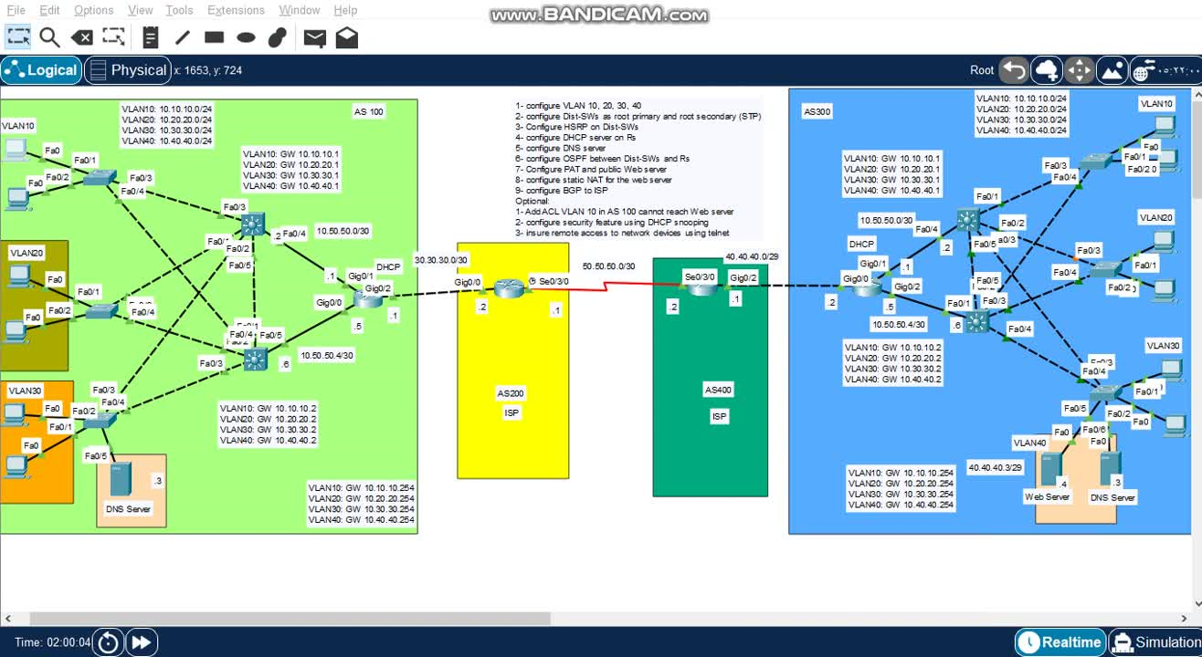
Conclusion and Recommendations
TESTING AND VALIDATION

Slide 13
TESTING AND VALIDATION
Conclusion and Recommendations
U
O
Y
K
N
A
H
T
The designed network is optimized for scalability, redundancy, and efficient communication between the two enterprises. OSPF and BGP are configured to ensure smooth internal and external routing. Future recommendations include the deployment of additional security layers like an Intrusion Detection System (IDS) and upgrading bandwidth for potential growth.

Slide 14
T
H
A
N
K
Y
O
U

